Slide 1
Streaming data processing in Azure and Preparing Dashboard
Services used :
Azure Event hub
Azure Stream Analytics
Azure Cosmos DB
Azure SQL Database
Tableau

Slide 2
Azure Event Hub
We created a Eventhub through our python script where it will scrape the data and stream to eventhub in a batches.
There is a github link for python script “https://github.com/karimulla2praxis/my_new_capstone_repo”
This will Stream to Eventhub as shown in the picture in next slide.

Slide 3
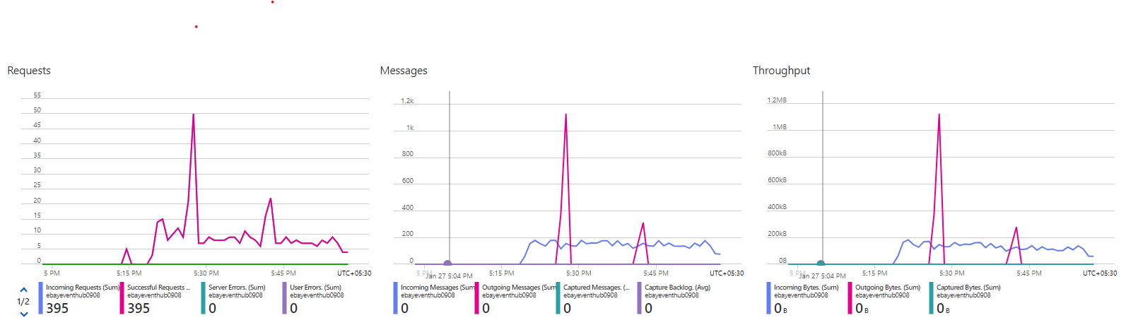
Data that is coming continuously from system to the Eventhub

Slide 4
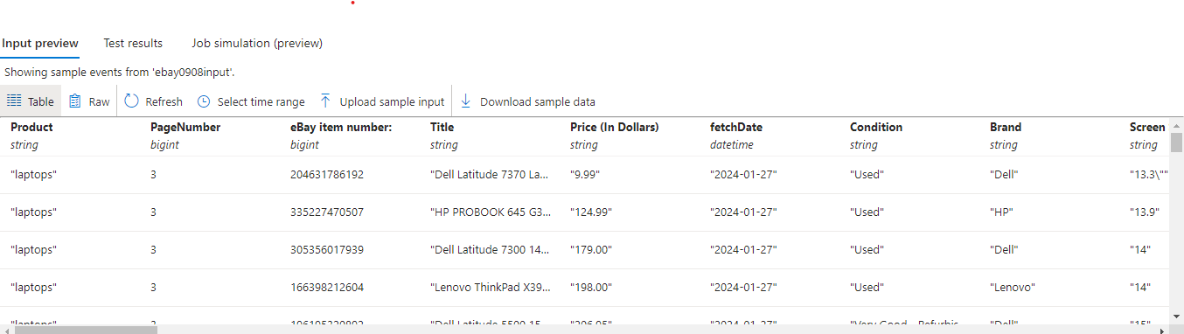
Data that is sending from Event hub to cosmos DB.

Slide 5
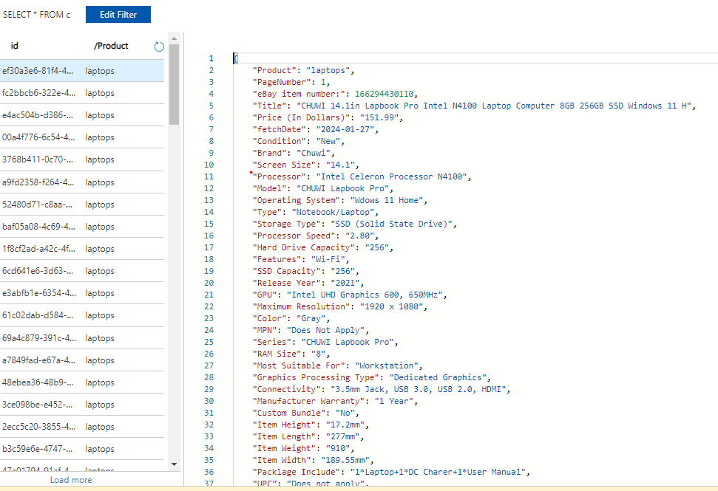
Data that is send to cosmos DB which is used as OLTP system

Slide 6
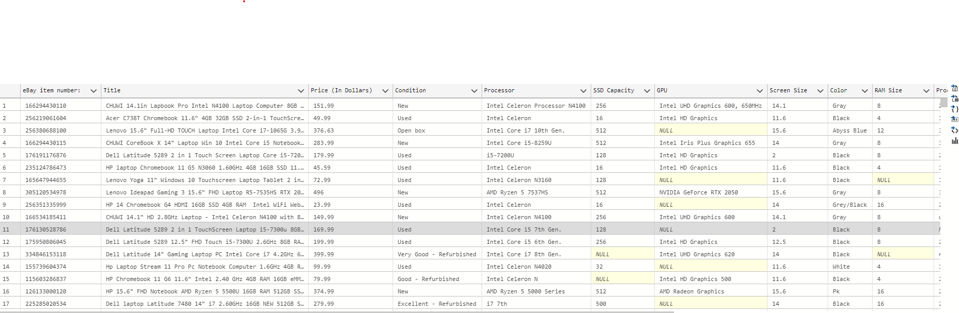
Sending Data from Azure SQL Database which is using as OLAP

Slide 7
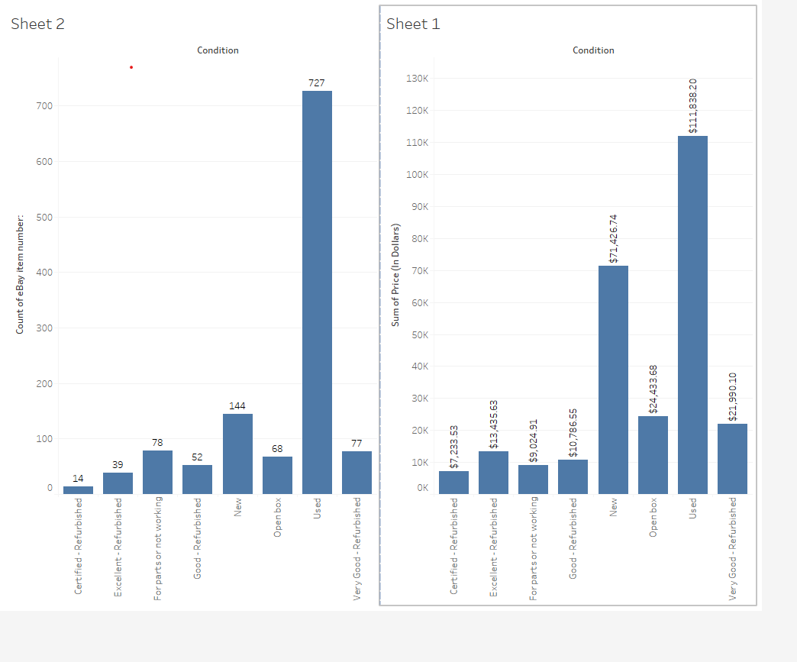
Connecting AZURE Database to Tableau and Build some Dashboard

Slide 8
Conclusion and Impact:
In conclusion, addressing this challenge requires the development of a robust data-driven solution that empowers consumers with accurate and up-to-date information about the features and value propositions of laptops and PCs in the market. By leveraging data engineering principles, we can create a system that aggregates, analyzes, and presents relevant product information, aiding consumers in making well-informed choices that align with their needs and preferences. This not only enhances consumer satisfaction but also fosters a more transparent and competitive electronics market.

